Slide 1

Multiple Disease
Prediction

Slide 2
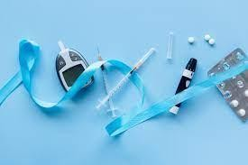
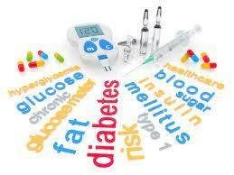
PROBLEM STATEMENT
Many of the existing machine learning models for health care analysis are concentrating on one disease per analysis. For example first is for liver analysis, one for cancer analysis, one for lung diseases like that. If a user wants to predict more than one disease, he/she has to go through different sites. There is no common system where one analysis can perform more than one disease prediction. Some of the models have lower accuracy which can seriously affect patient’s health. When an organization wants to analyse their patient’s health reports, they have to deploy many models which in turn increases the cost as well as time Some of the existing systems consider very few parameters which can yield false results. So, our model will predict five types of diseases. They are:
DIABETES
Doctors rely on common knowledge for treatment. When common knowledge is lacking, studies are summarized after some number of cases have been studied. But this process takes time, whereas if machine learning is used, the patterns can be identified earlier. (Perner, 2006) For using machine learning, a huge amount of data is required. There is very limited amount of data available depending on the disease. Also, the number of samples having no diseases is very high compared to number of samples actually having the disease.

Slide 3

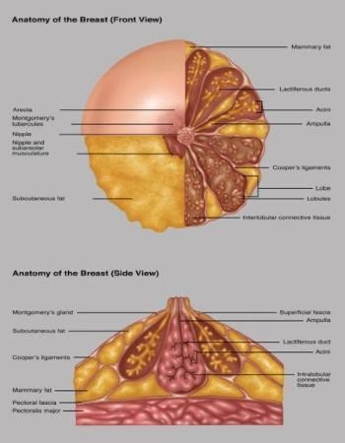
PROBLEM STATEMENT
BREAST CANCER
Breast Cancer is one of the leading cancer developed in many countries including India. Though the endurance rate is high – with early diagnosis 97% women can survive for more than 5 years. Statistically, the death toll due to this disease has increased drastically in last few decades. The main issue pertaining to its cure is early recognition. Hence, apart from medicinal solutions some Data Science solution needs to be integrated for resolving the death causing issue. This analysis aims to observe which features are most helpful in predicting malignant or benign cancer and to see general trends that may aid us in model selection and hyper parameter selection. The goal is to classify whether the breast cancer is benign or malignant. To achieve this we have used machine learning classification methods to fit a function that can predict the discrete class of new input.

Slide 4
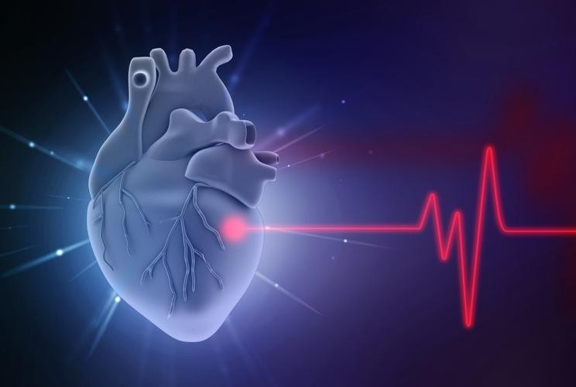
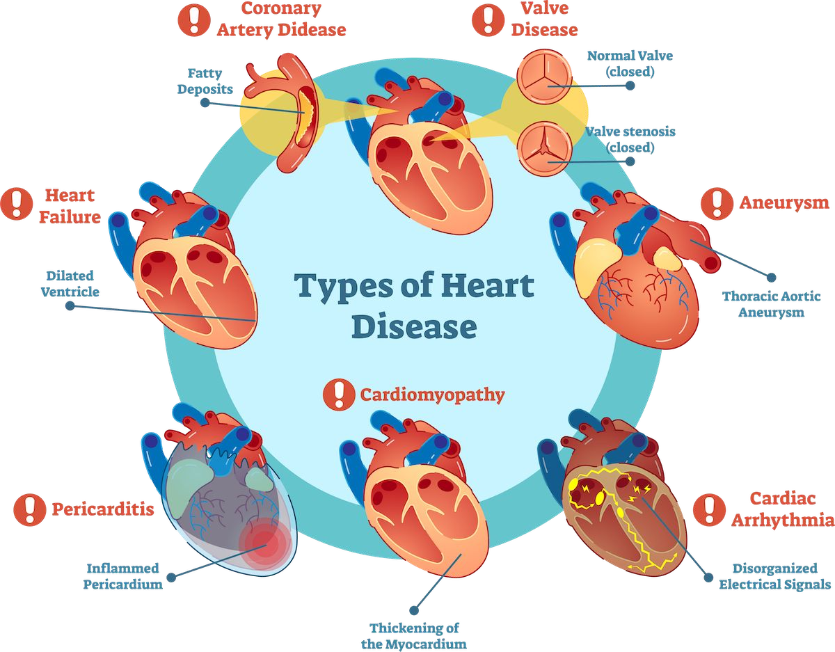
PROBLEM STATEMENT
HEART DISEASE
Heart disease can be managed effectively with a combination of lifestyle changes, medicine and, in some cases, surgery. With the right treatment, the symptoms of heart disease can be reduced and the functioning of the heart improved. The predicted results can be used to prevent and thus reduce cost for surgical treatment and other expensive. The overall objective of our work will be to predict accurately with few tests and attributes the presence of heart disease. Attributes considered form the primary basis for tests and give accurate results more or less. Many more input attributes can be taken but our goal is to predict with few attributes and faster efficiency the risk of having heart disease.
Decisions are often made based on doctor’s intuition and experience rather than on the knowledge rich data hidden in the data set and databases. This practice leads to unwanted biases, errors and excessive medical costs which affects the quality of service provided to patients. Data mining holds great potential for the healthcare industry to enable health systems to systematically use data and analytics to identify inefficiencies and best practices that improve care and reduce costs. According to (Wurz & Takala, 2006) the opportunities to improve care and reduce costs concurrently could apply to as much as 30% of overall healthcare spending. The successful application of data mining in highly visible fields like e-business, marketing and retail has led to its application in other industries and sectors.

Slide 5
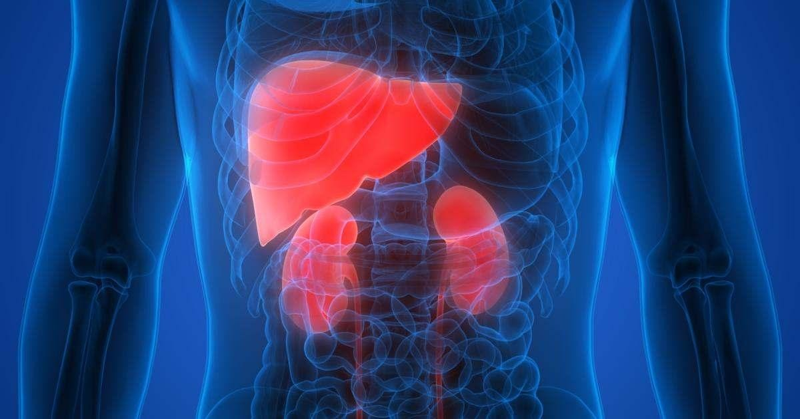
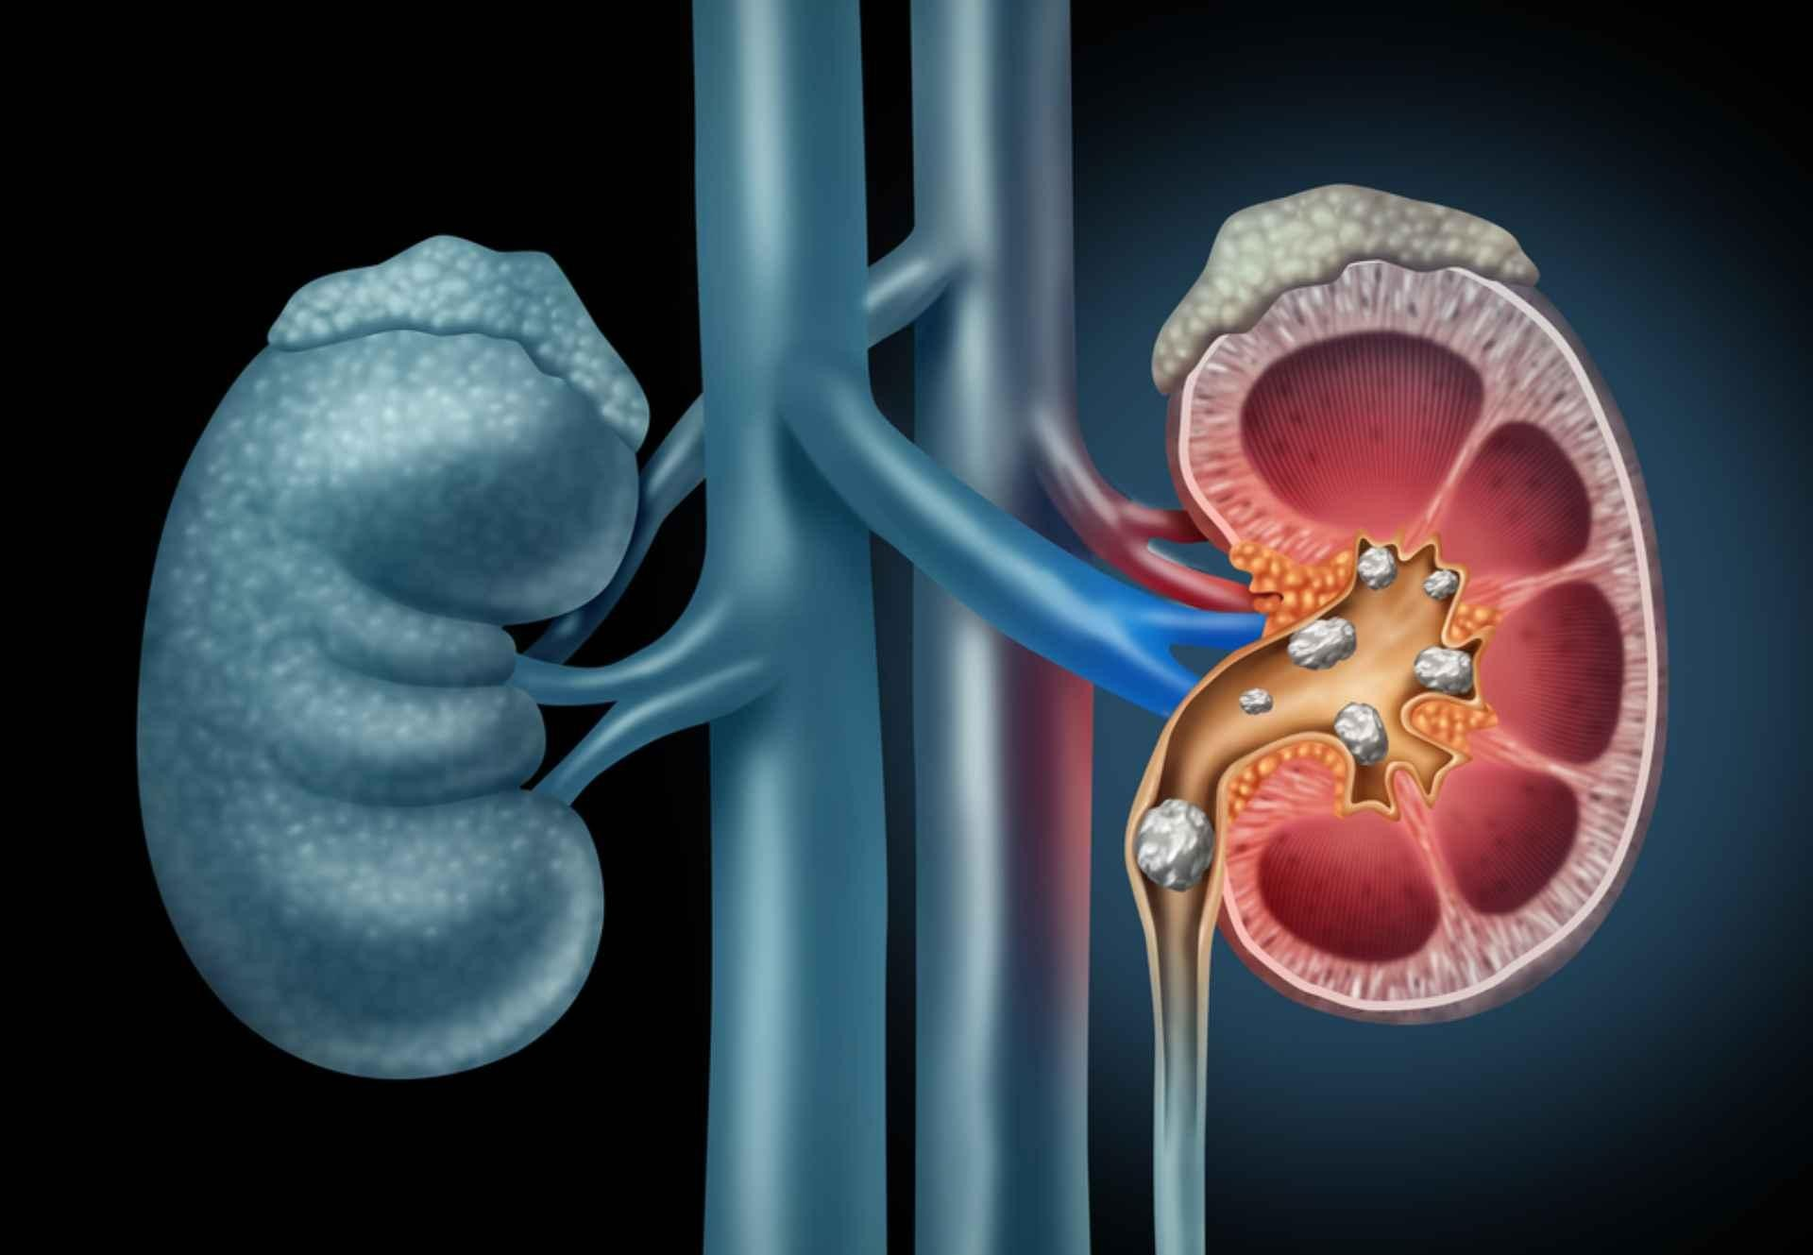
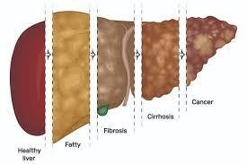
PROBLEM STATEMENT
CHRONIC KIDNEY DISEASE
CKD, in its early stages, has no symptoms; testing may be the only way to find out if the patient has kidney disease. Early detection of CKD in its initial stages can help the patient get effective treatment. It is argued that every year, a person that has one of the CKD risk factors, such as a family history of kidney failure, hypertension, or diabetes, get checked. The sooner they know about having this disease, the sooner they can get treatment. To raise awareness and to encourage those who are most susceptible to the disease to perform the tests periodically, we hope that the disease can be detected with the least possible tests and at low cost. So, the objective of this project is to provide an effective model to predict the CKD by least number of predictors.
LIVER DISEASE
This project aims to identify a suitable machine learning algorithm which is capable of identifying whether a person has liver disease or not. This is a binary classification problem to be solved using supervised learning. We have a label which identifies whether the patient is suffering from liver disease or not. In order to arrive at the solution, our aim should be to train various supervised learning models on this dataset so that we have a well performing model which is able to classify any new data point as a positive or negative with a reasonable degree of accuracy and perform better than the benchmarks.

Slide 6
Existing Work ( Other researchers’ contribution on the same problem)
Anuj Kumar , Analp Pathak
Student, Department of CSE & SRM Institute Of Science And Technology, NCR Campus , India Assistant Professor , Department of CSE & SRM Institute Of Science And Technology, NCR Campus , India
Abstract=> Machine Learning Approach for Identifying Disease Prediction Using Machine Learning is based on prediction modelling that predicts disease of the patients according to the symptoms provided by the users as an i/p to the system. This paper gives an idea of predicting multiple diseases using Machine Learning algorithms. Here we will use the concept of supervised Machine Learning in which implementation will be done by applying Decision Tree, Random Forest, Naïve Bayes and KNN algorithms which will help in early prediction of diseases accurately and better patients care. The results ensured that the system would be functional and user oriented for patients for timely diagnoses of diseases in a patient.

Slide 7
Jingwen Sun,Weixing Du,Niancai Shi
Information Engineering College, Panzhihua University of Technology, Sichuan, China
A Survey of kNN Algorithm
Abstract
The kNN algorithm is a well-known pattern recognition method, which is one of the best text classification algorithms. It is one of the simplest machine learning algorithms in machine learning classification algorithm. In this paper, we summarize the kNN algorithm and related literature, introduce the idea, principle, implementation steps and implementation code of kNN algorithm in detail, and analyze the advantages and disadvantages of the algorithm and its various improvement schemes. This paper also introduces the development of kNN algorithm, the important published papers. At the end of this paper, the application of kNN algorithm is introduced, and its implementation in text classification is emphasized.

Slide 8
Jingyu Xue1st, Fanchao Min2rd, Fengying Ma3nd,
Qilu University of Technology, Jinan, Shandong, China
e-mail: daoxiang.mo@163.com, e-mail: Min_FC@163.com,
Corresponding author: mafengy@163.com
Abstract => Diabetes mellitus (DM) is a metabolic disease characterized by high blood sugar. The main clinical types are type 1 diabetes and type 2 diabetes. Now, the proportion of young people suffering from type 1 diabetes has increased significantly. Type 1 diabetes is chronic when it occurs in childhood and adolescence, and has a long incubation period. The early symptoms of the onset are not obvious, which may lead to failure to detect in time and delay treatment. Long-term high blood sugar can cause chronic damage and dysfunction of various tissues, especially eyes, kidneys, heart, blood vessels and nerves. Therefore, the early prediction of diabetes is particularly important. In this paper, we use supervised machine-learning algorithms like Support Vector Machine (SVM), Naive Bayes classifier and LightGBM to train on the actual data of 520 diabetic patients and potential diabetic patients aged 16 to 90. Through comparative analysis of classification and recognition accuracy, the performance of support vector machine is the best.

Slide 9
Scope Of the Work
Mechanism of our Project:-
Our Project include 3 Libraries:-
i)pickle ii)streamlit iii)streamlit_option_menu
Flow chart of our project
Select dataset And
Load dataset
Pre-processing
Start
Classification
Feature Selection
Result

Slide 10
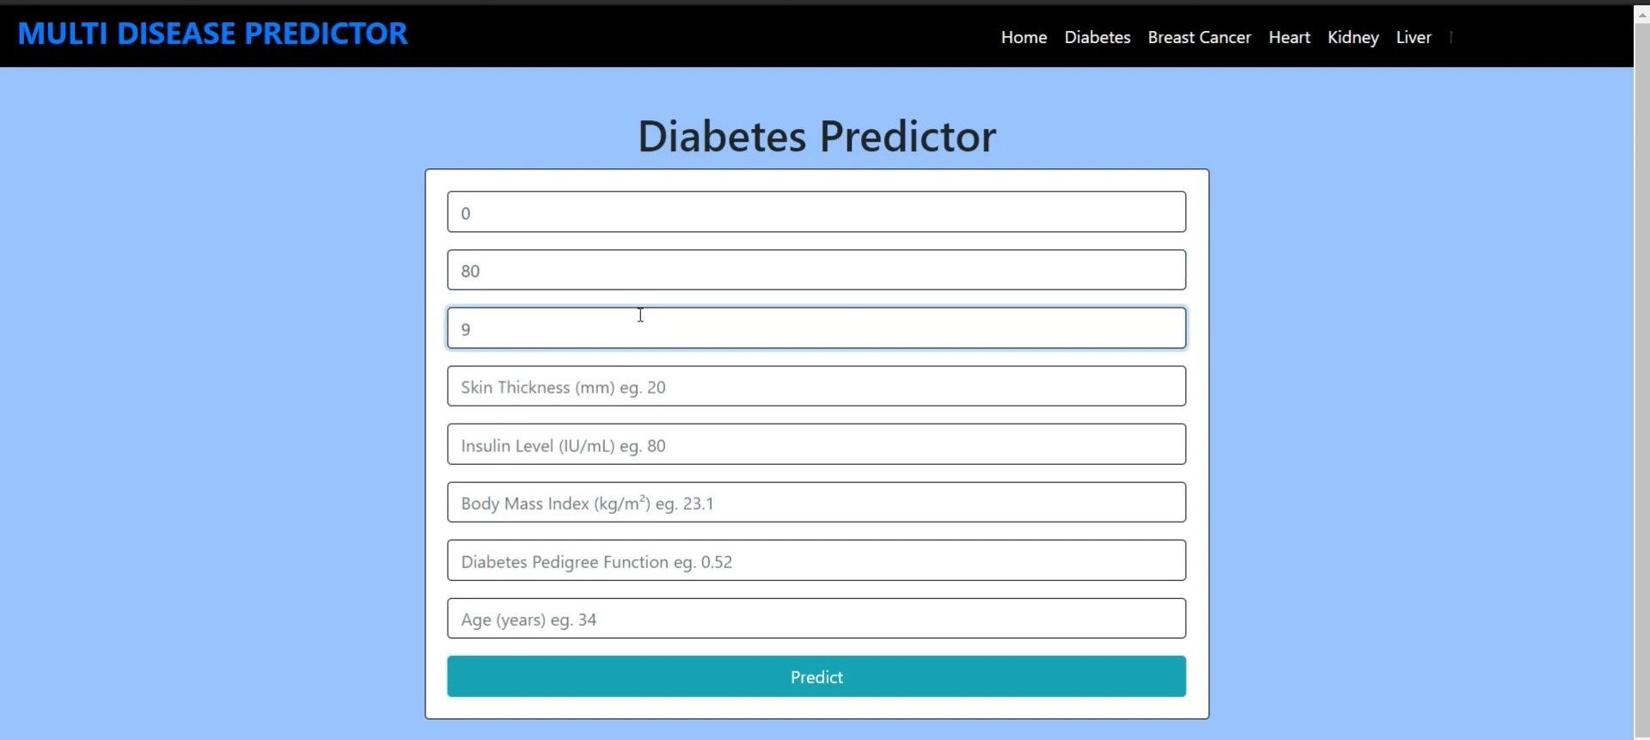
Includes input data for:-
i)Diabetes ii)Breast Cancer iii)Heart
iv)Kidney
v)Liver
Sample Web page

Slide 11
Our Contribution in this project:-
Let’s take diabetes as an example in this project we used KNN algorithm to evaluate the diabetes
The working of the K-NN algorithm is as followed:-
Step-1: Start to select the value of k let’s say for example k=5.
Step-2: Then we will find the Euclidean distance between the points. It is calculated by the as: Euclidean distance = root[(x2-x1)^2 + (y2-y1)^2)]
Step-3: Then we will calculate the Euclidean distance of the nearest neighbour.
Step-4: Then count the number of the data points in each category .For example found three values for Category A and two values for category B.
Step-5: Then assign the new point to the category having maximum number of neighbours. For example Category A has highest number of neighbour so we will assign the new data point to category A.
Step-6: So finally our Knn model is ready.

Slide 12
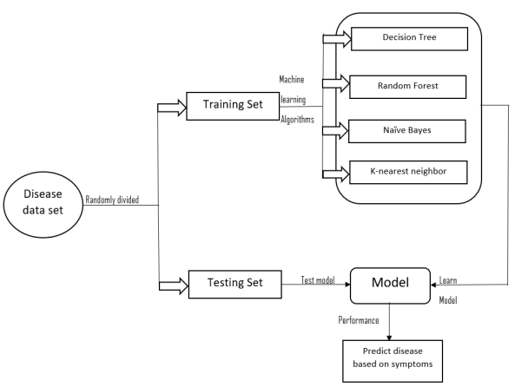
METHODOLOGY
Our project is stand on multiple disease prediction in accordance with symptoms entered by patient. The first task is to determine the problem statement. Then making the dataset ready to work on. After that we conceptualize our data using scatter plot, distribution graph, etc. by doing so we can find out anomalies, missing values, etc. on our data and make our dataset perfect for prediction. And finally the main feature will be Machine Learning in which we will be using algorithms like Decision Tree, Random Forest, Naive Bayes and KNN which will predict accurate disease for early prediction and better patient care. For this model, we have used python as a platform to execute our Machine Learning algorithms. We have also developed an elegant GUI to provide interaction with system.

Slide 13
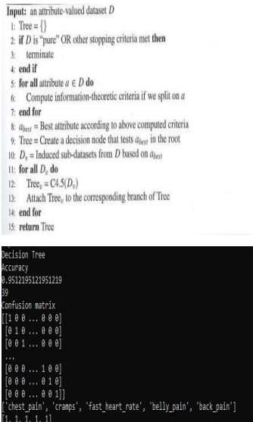
Decision Tree:-
It is a type of supervised Machine Learning algorithm that mainly deal with classification problem. The main objective of using decision tree is to make a training model that can be used to predict the class or values of the desired value by learning elementary decision procedure surmise from existing data (training data). In Decision Tree algorithm, we start from root of the tree to predict the class. We collate the values of the root trait with data's trait. On the basis of differentiation we go ground with the branch parallel to that value and move to next node. In this system Decision Tree splits the symptoms as per its classification and lowers down the dataset complexity. It is most effective Machine Learning algorithm to describe Decision tree in graphical manner. It deals with huge and complicated datasets without involvement of multiple parametric structure. With the help of training datasets , decision tree model is decided and a validation dataset decides appropriate tree size to achieve the optimal final model.

Slide 14
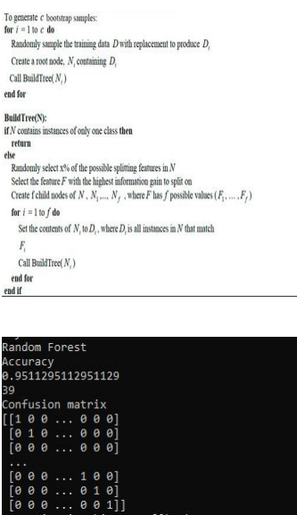
Random Forest:-
Random Forest comes under category of supervised Machine Learning algorithm. It is used for classification and regression but mainly deal with classification problems. The implementation of Random Forest is very easy and easy in use as well. Random Forest is a perfect substitute if we would like to develop a model in short notice. Random Forest is an ensemble learning method that works by creating a horde of decision tree at training time. It selects the best solution by means of voting. Simply Random Forest is composed of multiple decision tree. It creates forest of trees. The number of tress in the forest is directly proportional to the accuracy rate and it prevents the problem of overfitting. Random Forest produces good results over actual problems mainly due to insensitive to noise in the dataset and is not based on overfitting. It works greatly and shows an excellent execution over other tree based algorithms. For tree learning, it mainly use bootstrap aggregation or bagging.
For a given data, X = {m1,m2,m3,…mn} with responses Y = {m1,m2,m3,….mn} which repeats the bagging from b=1 to B.

Slide 15
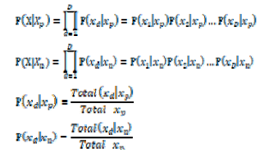
Naïve Bayes Classifier:-
Naive Bayes classifier is a series of simple probability classifiers based on the use of Bayes' theorem under the assumption of strong (naive) independence between features. The classifier model assigns class labels represented by feature values to problem instances, and class labels are taken from a limited set. For the given item to be classified, the probability of each category appearing under the condition of the occurrence of the item is solved, whichever is the largest, and the category to be classified is considered to be. This prediction of the most likely class by probability is suitable for diabetic prediction. The specific classification formulas are shown. Where represents people who are at risk of diabetes, represents people who are not at risk of diabetes, and X is the data set. Here D is the attribute with D dimension.

Slide 16
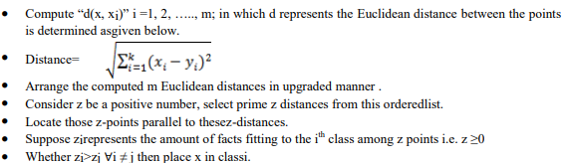
KNN:-
KNN is a supervised learning algorithm that use data and classify new data points on similarity measures . It is a non parametric method that implies it does not consider any assumption on underlying data. KNN is also a lazy learner method because it does not perform training at all and it does not pursue any discriminatory function from training data instead it retains the training dataset. KNN based on the idea of feature similarity approach i.e. it considers that the homogeneous things exist in a close proximity. It is also an instance based learning algorithm where the function is approximately locally [2]. This algorithm handles large of amount of data and used where there are non linear decision division between classes .KNN not only handles function approximation problem but also robust to noisy training data. KNN is used to calculate distance between new data point and each training point using distance function.

Slide 17
Dataset And Model Description:-
In this section we are going to elaborate the dataset which is used in this project to train the Machine Learning model. The dataset we have used for this project is in the structured format. The dataset which is being used contains all the names of diseases with its respective symptoms. Since this system is based on supervised Machine Learning algorithm, the dataset is labelled with 0 or 1. After this, we have divided the dataset into two phases i.e. training dataset and testing dataset . we trained our models using training dataset and then we applied our all Machine Learning algorithms to this training dataset to get trained Machine Learning model. At last we provided the testing dataset to this trained model to test the accuracy of model.
Dataset Of Hospital:-
The dataset of hospital will be in the form of structured format .The dataset that we used is real life hospital data and data stored in data center. The data provided by hospital contains symptoms of patients. The dataset is connected into either 0 or 1 where the value 0 represents feature/ symptoms impacts on disease and the value 1 represents that it does not have any impact on disease. This dataset is a disease symptoms produced by a mechanized system on the basis of information in textual discharge summaries of patients at New York Presbyterian hospital.

Slide 18
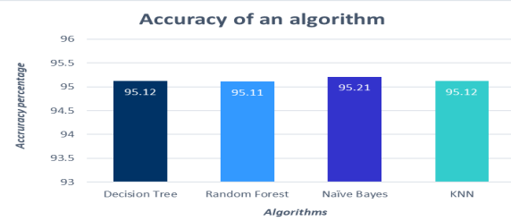
Results:-
This section represents the proposed system results which can predict the disease faster, more accurate and with high reliability than the existing system. The results are obtained by implementing various Machine Learning algorithms. The Machine Learning classification techniques namely decision Tree, Random forest, Naïve Bayes and KNN are implemented using Python programming.
This system also has an elegant interface which takes all the necessary inputs for the evaluation and to facilitate with the system which is very easy to use. The final result of our proposed system can be viewed from this GUI.
The proposed system also has a facility of Database for storing the data entered by the end users along with the name of the disease the patient is suffering from that may be used for future references thereby making this system more helpful and easier than the other system for this job.

Slide 19
Conclusion
The main aim of this paper is to predict the disease in accordance with symptoms put down by the patients with proper implementation of Machine Learning algorithm. In this paper we have used four Machine Learning algorithm for prediction and achieved the mean accuracy of more than 95% which shows remarkable rectification and high accuracy than previous work and also makes this system more reliable than the existing one for this job and hence provides better satisfaction to the user in comparison with the other one. It also stores the data entered by the user and the name of the disease the patient is suffering from in the Database which can be used as past record and will help in future for future treatment and thus contributing in easier health management .We have also created a GUI for better interaction with the system by users which is very easy to operate .This paper shows that Machine Learning algorithm can be used to predict the disease easily with different parameters and models. In the end we can say that our system has no threshold of the users because everyone can use this system.
Future Scope:-
There are many possible improvements that could be explore to diversify the research by discovering and considering extra features. Due to time boundation , the following work required to be performed in future. There is plan to use more classification techniques/methods, different discretization techniques, multiple classifier voting methods. Would like to use different rules such as association rule and various algorithms like logistic regression and clustering algorithms. In future, willing to make use of filter based feature selection methods in order to achieve more appropriate as well as functional result.

Slide 20
References
1. Khurana, Sarthak . , Jain, Atishay ., Kataria ,Shikhar. ,Bhasin ,Kunal . , Arora ,Sunny . ,& Gupta , Dr.Akhilesh . Das. (2019). Disease Prediction System.International Research Journal Of Engineering and Technology , 6(5) , 5178-5184.
2. Kamboj ,Mgha. (2020).Heart Disease Prediction with Machine Learning Approaches.International Journal Of Science and Research , 9(7) , 1454-1458.
3. Ware,Miss.Sangya . , Rakesh,Mrs.Shanu. K.,&Choudhary,Mr.Bharat . (2020). Heart Attack Prediction By Using Machine Learning Techniques. International Journal Of Recent Technology and Engineering , 8(5), 1577- 1580.
4. Shirsath ,Shraddha.Subhash .,& Patil , Prof. Shubhangi . (2018).Disease Prediction Using Machine Learning over Big Data .International Journal Of Innovative Research in Science and Technology , 7(6), 6752-6757.
5. Marimuthu , M. , Abinaya, M. ,Hariesh,K.S., Madhan,K.,& Pavithra, Kumar. V.(2018).A Review of Heart Disease Prediction Using Machine Learning and Data Analytics Approach .International Journal of Computer Application , 181(18), 20-25.

